Slide 1
Tribhuvan university institute of engineering Lalitpur engineering college
FINAL PROJECT DEFENSE ON
“Soccer Analysis”
Supervisor
Er. Praches Acharya
Presenter
ANISH MANDAL[LEC078BCT002]
KRISTAL SHRESTHA[LEC078BCT014]
PRADIP POKHREL MAGAR[LEC078BCT023]
RADHESH RAM GAMAL[LEC078BCT027]
March 14, 2025

Slide 2
OUTLINES
Introduction
Problem Statement
Project Objectives
Scope of Project
Project Application
Originality of Project
Methodology
Results
Discussion and Analysis
Future enhancement
Project Schedule
References
2

Slide 3
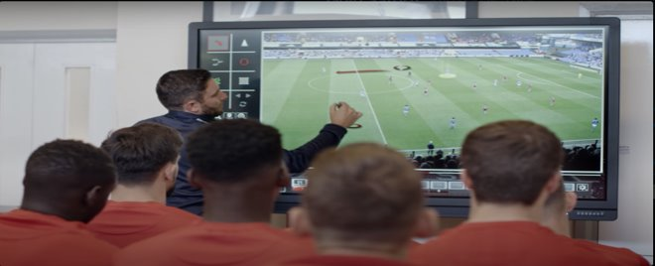
INTRODUCTION
Soccer Analysis is a web application that utilizes machine learning to track players, referees, and the ball while calculating player performance metrics using YOLO and ByteTrack, with a Flask-based interface for user interaction.

Slide 4
PROBLEM STATEMENT
Traditional football match analysis is inefficient, time-consuming, and subjective, relying on manual observation or costly tracking systems.
Existing deep learning models like Faster R-CNN and SSD struggle with occlusion handling, tracking accuracy, and fast-moving objects, limiting their effectiveness.
In football analytics, it's difficult to study performance because there aren't cheap methods to identify and track players, referees, and the ball. This lack of affordable solutions makes it challenging to analyze how well everyone has done in field.

Slide 5
MOTIVATION
Understanding player movements and team strategies is essential for match analysis.
Manual tracking is time-consuming and error-prone.
Automating the process can help coaches, analysts, and fans gain better insights.

Slide 6
PROJECT OBJECTIVES
The objective of our project is
To develop a object detection and tracking system for football videos.
To analyze player movement by calculating key performance metrics such as speed and distance covered.

Slide 7
PROJECT APPLICATION
Player Performance Analysis
Tactical Decision-Making
Player Scouting & Recruitment
Potential for Sports Broadcasting

Slide 8
ORIGINALITY OF PROJECT
Provides an accessible and cost-effective solution for soccer match analysis using a single-camera setup.
Automates player tracking, ball possession stats, and movement analysis without requiring expensive hardware.
Enables wider adoption by offering a user-friendly, web-based tool for coaches, analysts, and enthusiasts.

Slide 9
LITERETURE REVIEW
Object Detection in Sports – Deep learning models like Faster R-CNN and SSD have been used, but YOLO is preferred for faster detection due to its speed and efficiency.
Player Tracking – Traditional methods like SORT and DeepSORT track players, but ByteTrack improves accuracy, especially when players are occluded.
Ball Possession & Team Assignment – Color-based clustering, such as KMeans, helps identify teams, and we use this approach in our project.
Speed & Distance Calculation – Motion analysis in sports often uses optical flow and positional tracking techniques.

Slide 10
LITERATURE REVIEW
Perspective Transformation – Homography transformation helps measure player movements more accurately.
Camera Movement Estimation – Optical flow methods help stabilize tracking when the camera moves, improving detection in dynamic scenes.

Slide 11
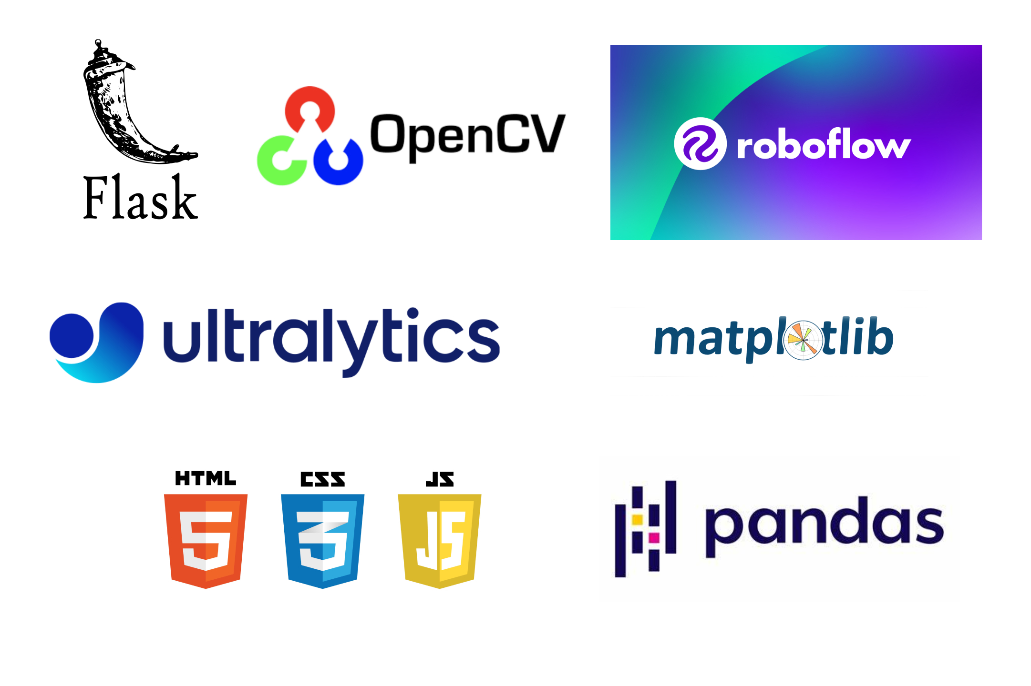
METHODOLOGY – THEORETICAL BACKGROUND

Slide 12
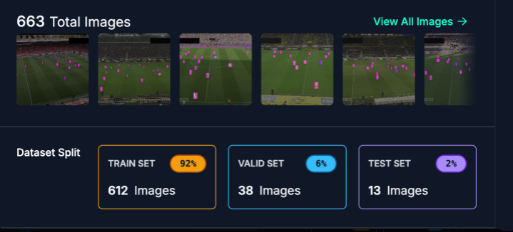
METHODOLOGY-[1] Data collection
Football images was fetched from Roboflow website for customizing our YOLO model. Data preprocessing included resizing, frame extraction, and format conversion. Annotation was performed to label players, referees, and the ball on the data for training and validation.

Slide 13
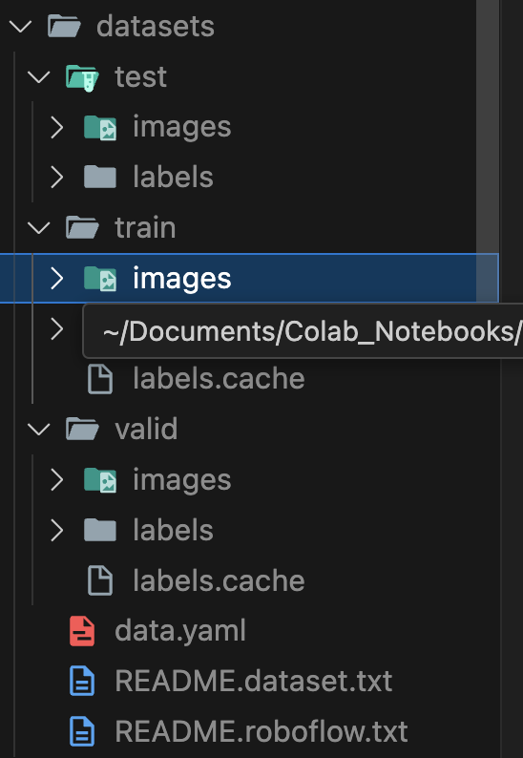
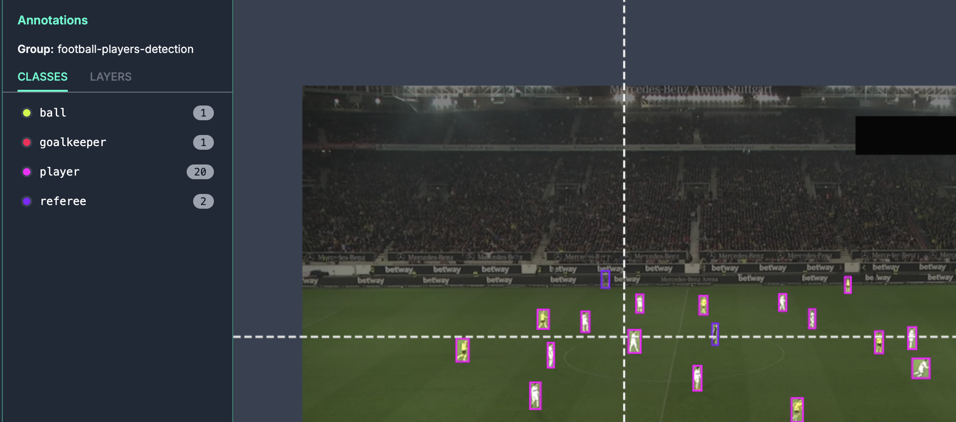
METHODOLOGY-[2] Data Labelling

Slide 14
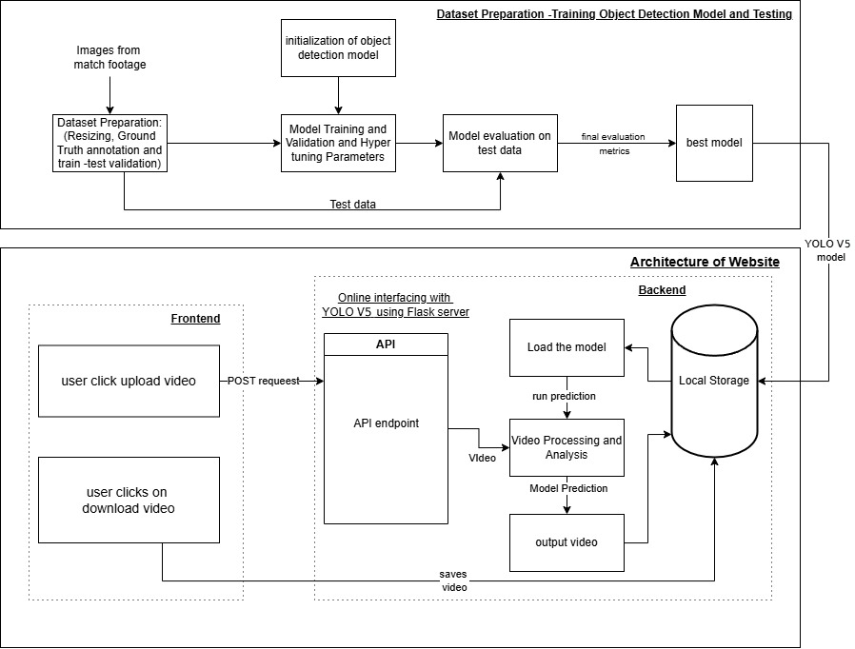
METHODOLOGY -[3]​
SYSTEM BLOCK DIAGRAM

Slide 15
METHODOLOGY-[4]
Our project's system block diagram mainly consists of two tasks:
Data Preparation and Model training
Website Development for Inference

Slide 16
METHODOLOGY-[5]
Dataset Preparation & Model Training:
Collect images from match videos.
Preprocess data (resizing, annotation, train-test split).
Train YOLO v5 with validation and hyperparameter tuning.
Evaluate models and select the best-performing one.

Slide 17
METHODOLOGY-[6]
Website Development for Inference:
A website with a frontend as UI for video upload/download and backend as Flask API.
The backend loads the trained model, processes videos, detects and track objects in frames.
And then outputs a video with annotated detected objects and is saved for user download.

Slide 18
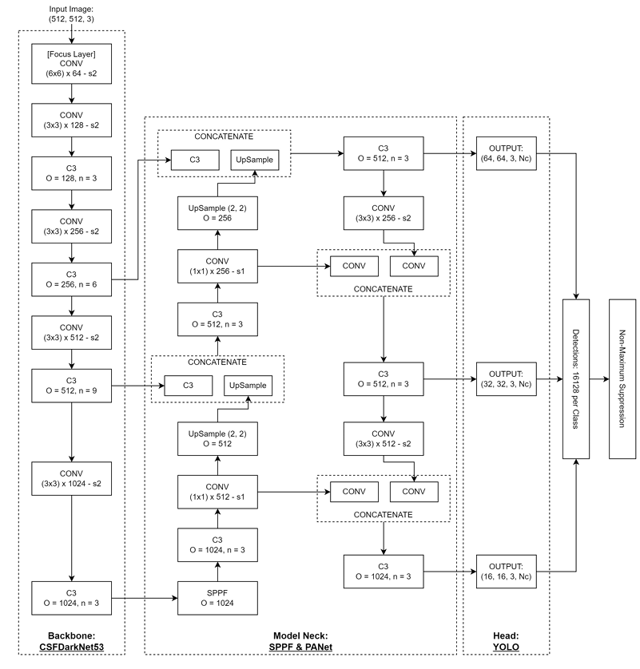
METHODOLOGY-[7] Architecture of YOLOv5

Slide 19
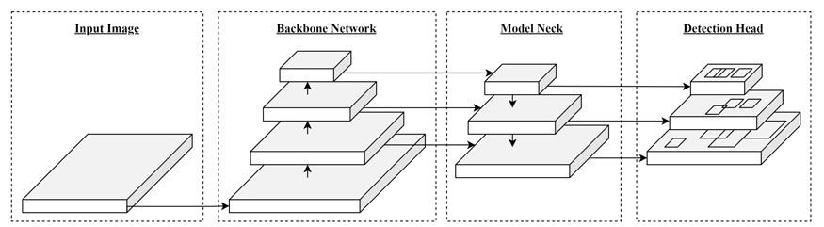
METHODOLOGY-[9] High Level Architecture of YOLOv5

Slide 20
METHODOLOGY-[10]
The main components of Yolov5 model are:
Backbone: CSPDarknet53 for feature extraction.
Neck: Uses SPPF & PANet for better feature fusion.
Head: YOLOv3-style detection head for final prediction.

Slide 21
METHODOLOGY-[11]
There are key layers in Yolov5:
CONV Layer: Uses Conv2D + Batch Normalization + SiLU activation for better learning.
CSPBottleneck (C3) Layer: Improves accuracy and reduces redundant gradient flow using CSPNet.
SPP-Fast (SPPF) Layer: Extracts important spatial information, useful for detecting blurred objects.

Slide 22
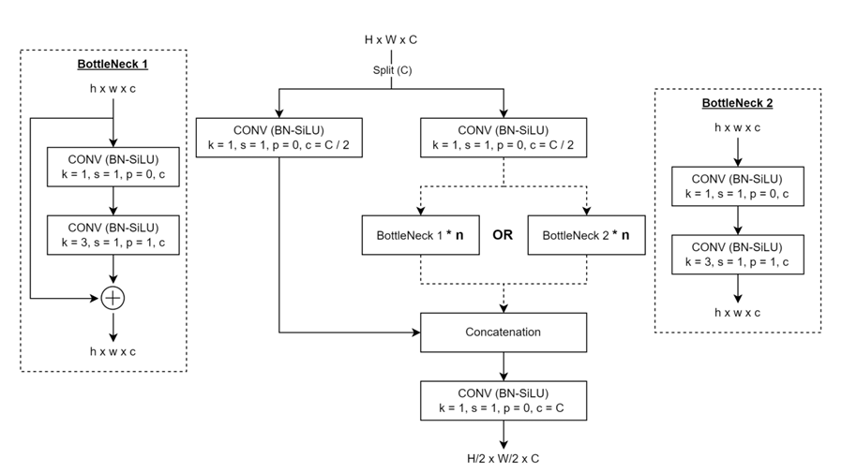
METHODOLOGY-[12] CSPBottleneck(C3) Layer Architecture

Slide 23
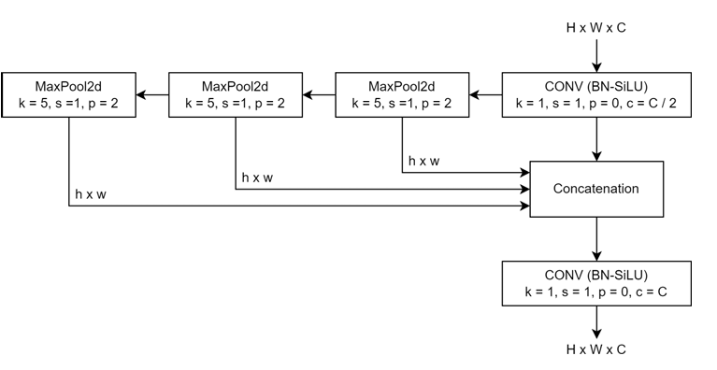
METHODOLOGY-[13] SPPF Layer Architecture

Slide 24
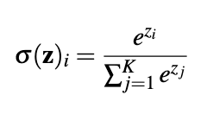
METHODOLOGY-[14] Softmax Activation Function
We use softmax activation function in output layer so that the our output ranges from 0 to 1 as probabilities with their sum as 1,which is helpful for multiclass classification task.
The softmax function is defined as:
where, z is the vector of raw outputs from the neural network and e = 2.718

Slide 25
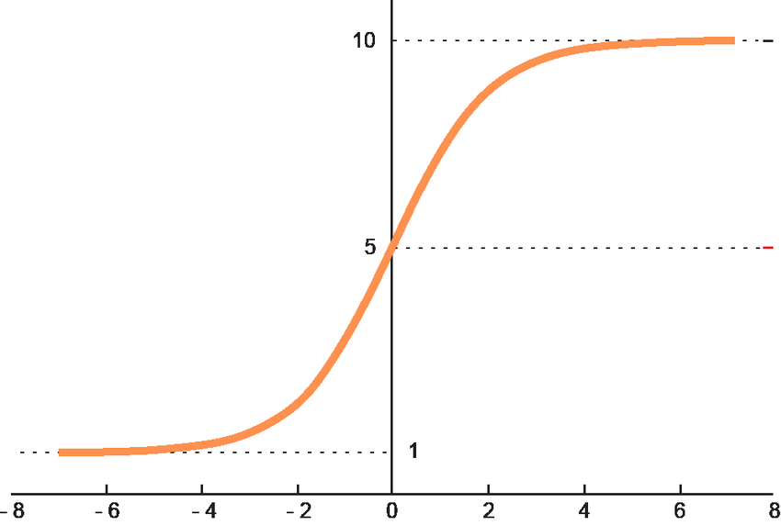
METHODOLOGY-[15] Softmax Activation Function-[2]

Slide 26
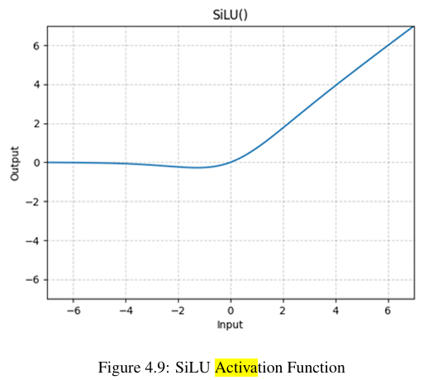
METHODOLOGY-[16] SiLU Activation Function
SiLU is an activation function defined as SiLU(z) = z × sigmoid(z), which helps neural networks learn smoothly by scaling inputs with the sigmoid function.

Slide 27
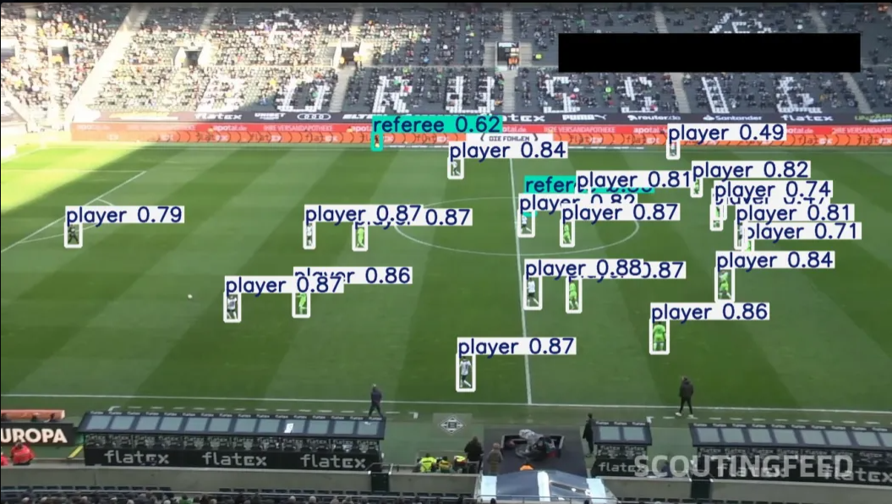
METHODOLOGY [17]
YOLO Object Detection: Identifies players, referees, and ball.

Slide 28
METHODOLOGY-[18]
Byte Track
​
What is Byte Track?​
Byte Track is a tracking system that follows players across video frames, ensuring accurate tracking even when players are blocked or move quickly.
It effectively handles fast-paced environments by linking low-confidence detections across frames, providing reliable tracking in dynamic conditions.

Slide 29
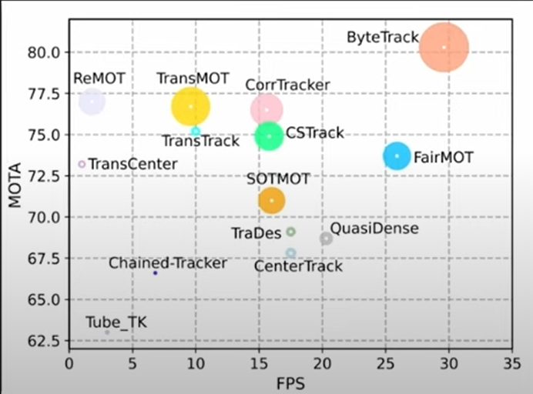
METHODOLOGY-[19]
Byte Track -[2]
Why we selected Byte Track?

Slide 30
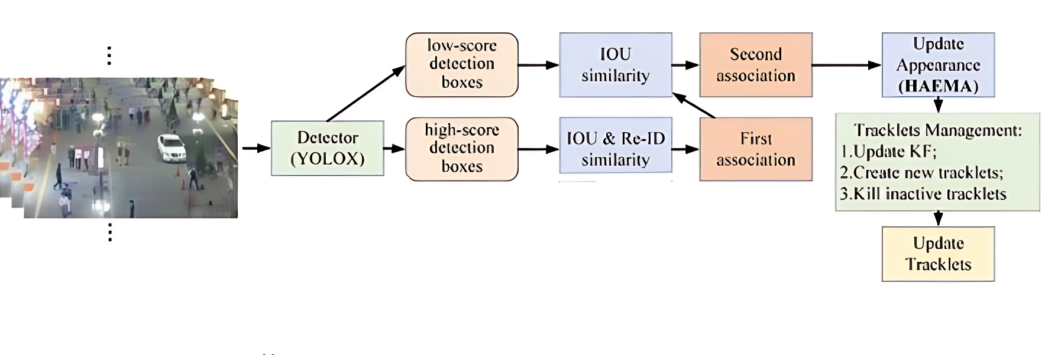
METHODOLOGY-[20]
Byte Track -[3]
Working mechanism of Byte Track

Slide 31
METHODOLOGY-[21] Corner and Edges Detection
Flat region: The intensity remains constant when moved in any direction.
Edges: The intensity changes significantly across the edge but has minimal changes along the edge.
Corners: The intensity changes significantly in any direction.

Slide 32
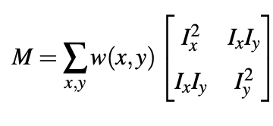
METHODOLOGY-[22] Harris Corner Detection
The Harris matrix (M) captures local intensity changes, with eigenvalues (λ₁, λ₂) indicating intensity change strength in perpendicular directions, where large eigenvalues suggest a corner, one large eigenvalue suggests an edge, and small eigenvalues indicate a flat region.

Slide 33
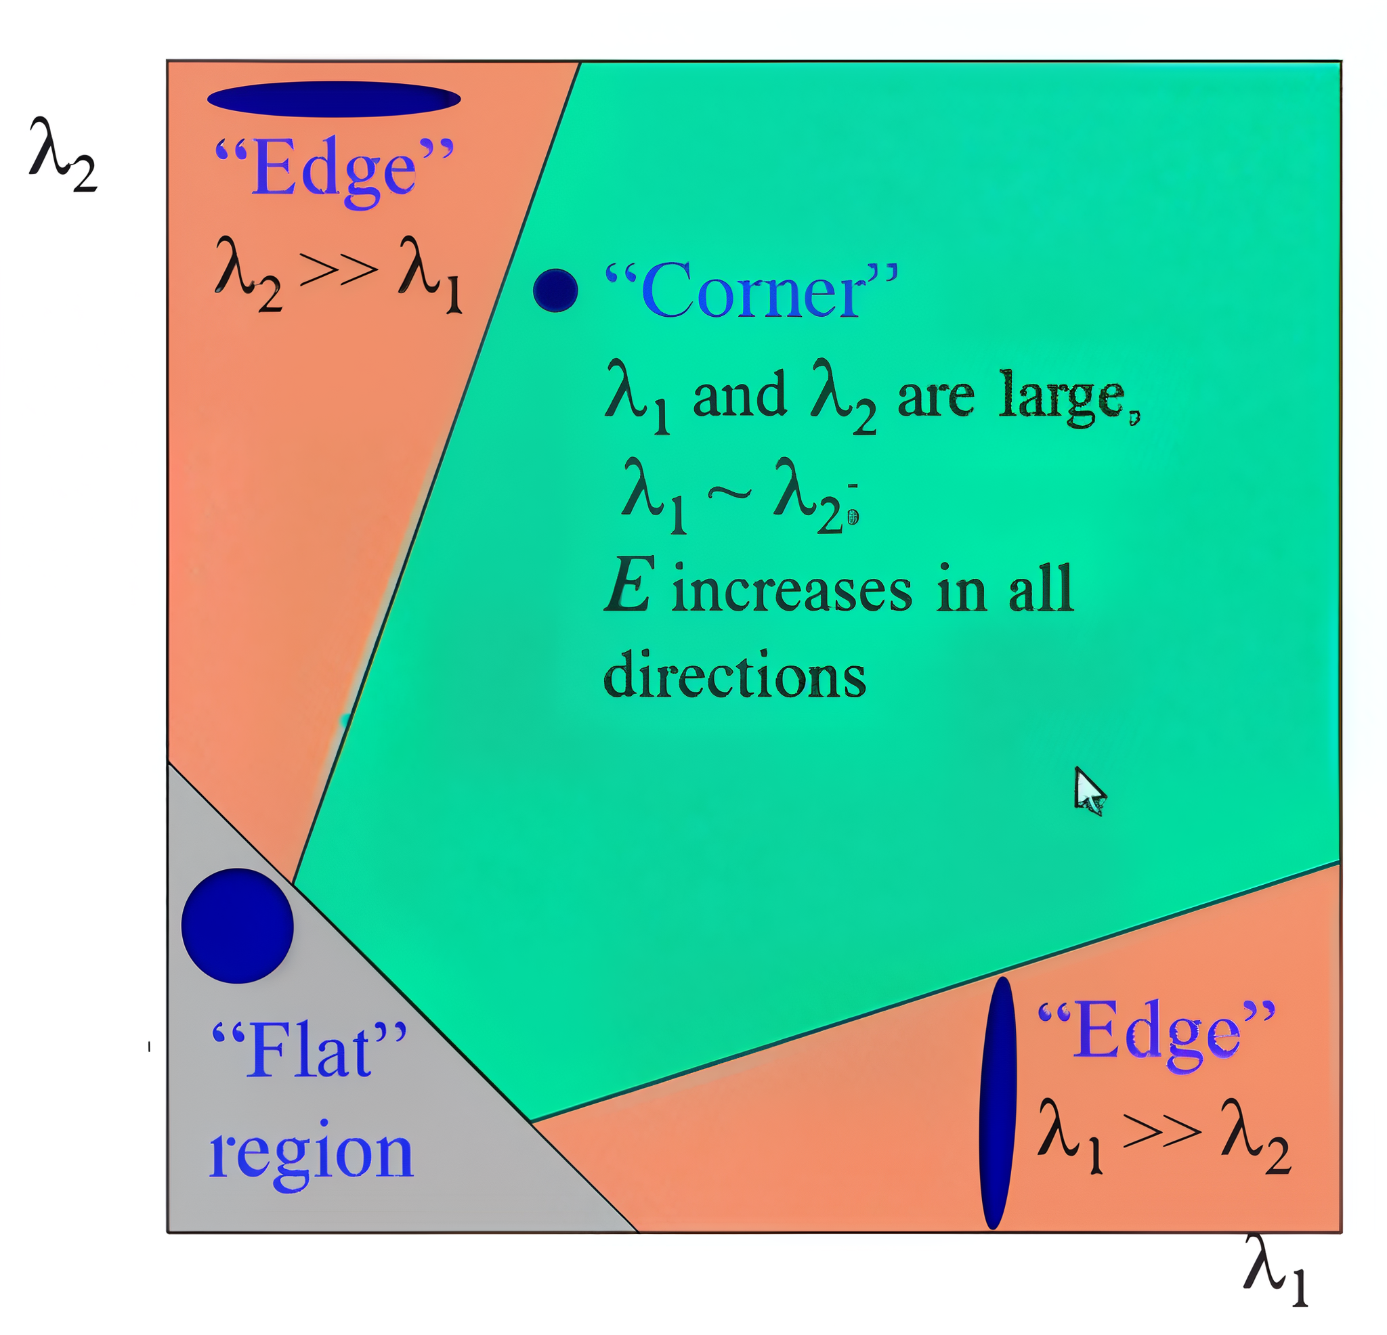
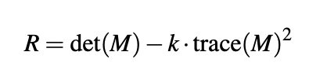
METHODOLOGY-[23] Harris Corner Detection[2]
The corner response function is :
Where
det(M)=λ1.λ2
trace(M)=λ1 + λ2
k is an empirical constant (typically 0.04-0.06)

Slide 34
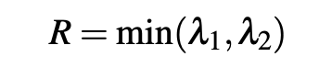
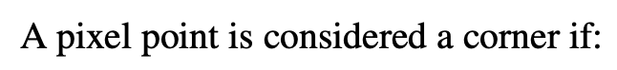
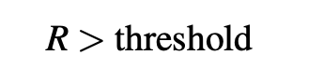
METHODOLOGY-[24] Shi-Thomasi Corner Detection
Unlike the Harris corner detection which uses a composite score function, Shi-Tomasi uses the minimum eigenvalue of the M which is computationally faster.

Slide 35
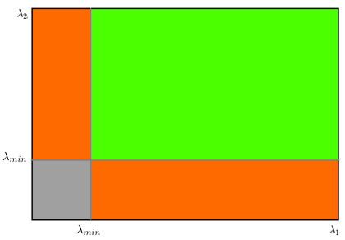
METHODOLOGY-[25]
Shi-Thomasi Corner Detection[2]
From the figure, we can see that only when λ1 and λ2 are above λmin a minimum value,it is considered as a corner(green region).

Slide 36
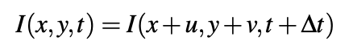
METHODOLOGY-[26] Camera Movement Estimation
After detecting corners, Now for estimating the camera movement, we are using Lucas Kanade Optical Flow.
Lucas Kanade Optical Flow assumes that the intensity of a particular point remains constant between frames ,also assuming that the displacement are always small between frames.
Where u and v are optical flow in x and y dirn (unknown).

Slide 37
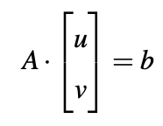
METHODOLOGY-[27] Camera Movement Estimation-[2]
For a window of pixels, we obtain a system of equations:
Where
A is an N ×2 matrix containing the spatial derivatives (w.r.t x and y) for each pixel in the window
b is an N ×1 vector containing the negated temporal derivatives (w.r.t t)

Slide 38
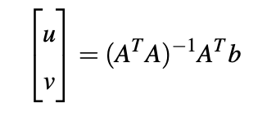
METHODOLOGY-[28] Camera Movement Estimation-[3]
The Lucas-Kanade algorithm approximates this optical flow by locally solving the optical flow equations using least-square. The least square solution is

Slide 39
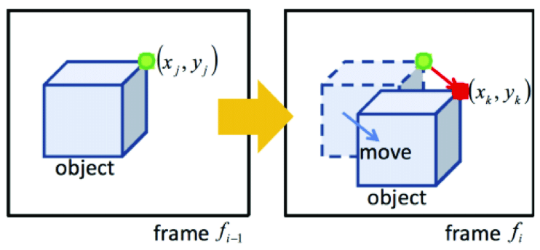
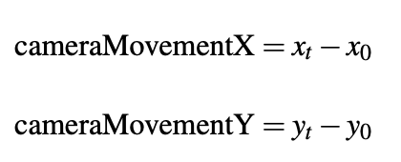
METHODOLOGY-[29] Camera Movement Estimation-[4]
After finding the u and v which can be referred as "CameraMovementX" and "CameraMovementY".
Now we just have to subtract the predicted value of objects with u and v so that we get the actual prediction.

Slide 40
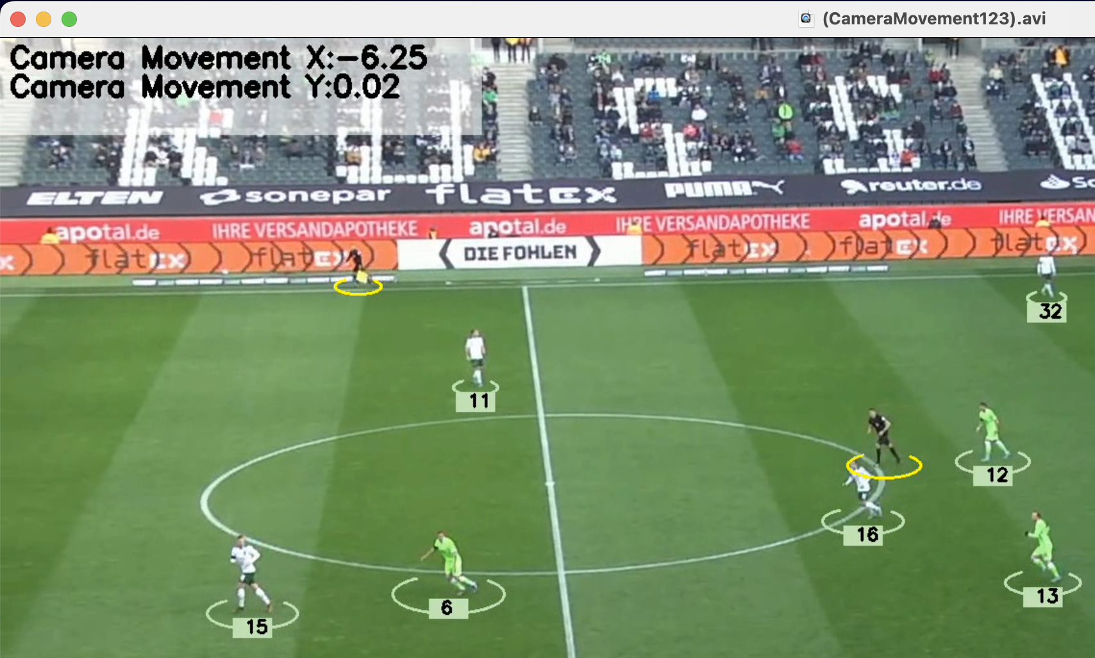
METHODOLOGY-[30] Camera Movement Estimation-[5]

Slide 41
METHODOLOGY-[31] Perspective Transformation
Our next problem was the calculation of speed and distance ,since we can't calculate those in pixel coordinates as they will be wrong. We need to convert the pixel coordinated to real world coordinates by perspective transformation using homography so that our estimated distance and speed will be correct.
Homography is a mathematical transformation that maps points from one plane to another.

Slide 42
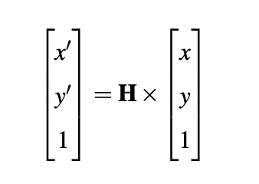
METHODOLOGY-[32] Perspective Transformation-[2]
The homography transformation can be represented using the following matrix equations:
Where
x',y' are top-down view
x,y are angled view

Slide 43
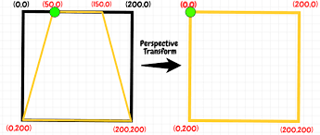
METHODOLOGY-[33] Perspective Transformation-[3]

Slide 44
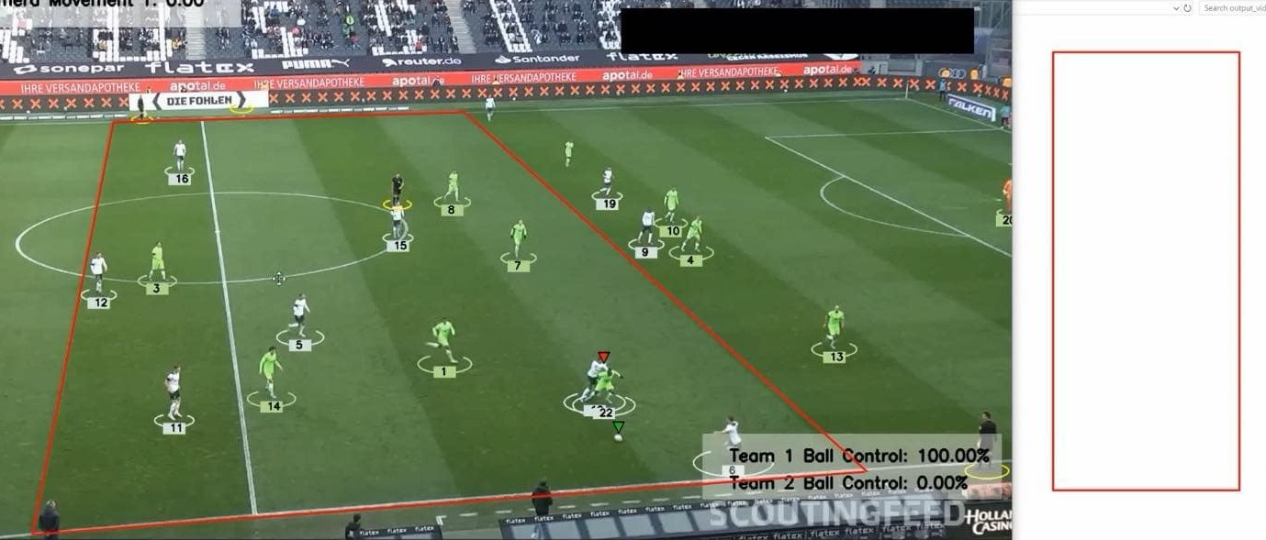
METHODOLOGY-[34] Perspective Transformation

Slide 45
METHODOLOGY-[35] Ball Interpolation
Since ball is small compared to other objects, it is hard to predict for the ball. Our model is failing to predict the ball so for that we would be using interpolation and predicting in frames where ball are missing.
We would be using linear interpolation because they are computationally faster.
This way, the ball would be predicted in every frames and ball will seem to be tracked.

Slide 46
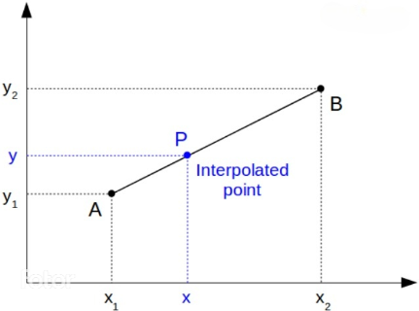
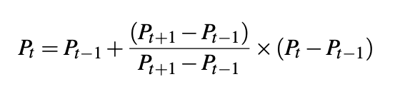
METHODOLOGY-[36] Ball Interpolation-[2]
Formula for interpolation:

Slide 47
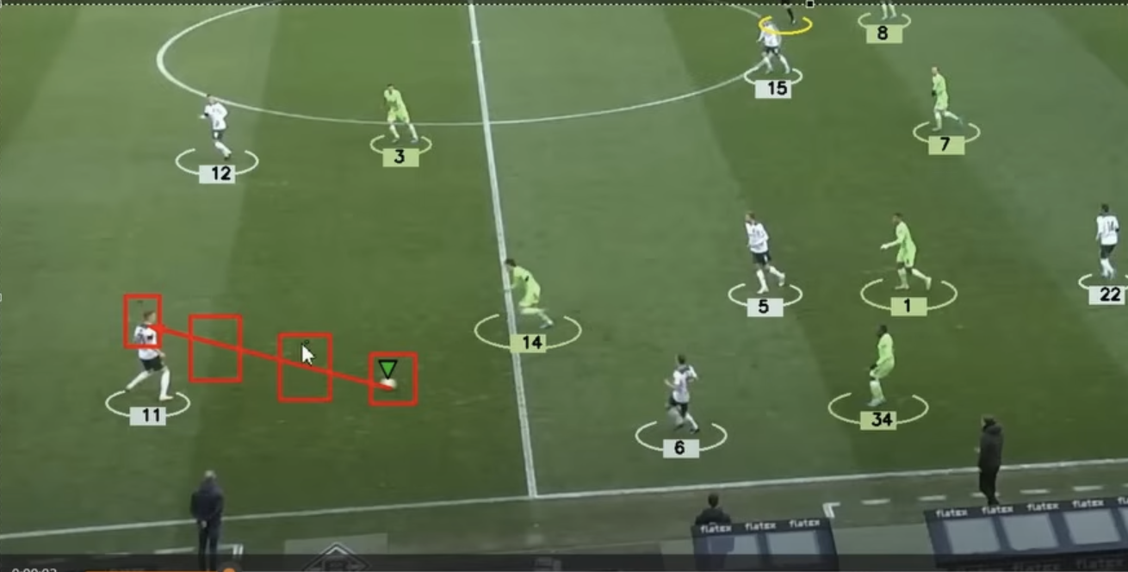
METHODOLOGY-[37] Ball Interpolation-[3]

Slide 48
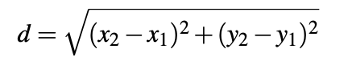
METHODOLOGY-[38] Estimating speed and distance
Now, we solved all issues related to transformation, camera movements and ball missing. We can accurately calculate the speed and distance of the players.
For distance calculation, we will be using simple Euclidean distance formula.

Slide 49
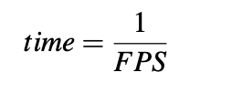
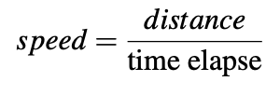
METHODOLOGY-[39] Estimating speed and distance -[2]
First, we need to calculate time between frames. Then we can calculate speed. We are calculating speed after every 5 frames, such that the annotation of change in speed shown is not fluctuating continuously , and we can see the change smoothly.

Slide 50
METHODOLOGY-[40] Team Assignment
Now we have to assign players to their team based on their jersey colors. We will be using K-means clustering.
First, we need to distinguish players from the background using K-means clustering. Then again we have to distinguish players from each other using K-means clustering again.

Slide 51
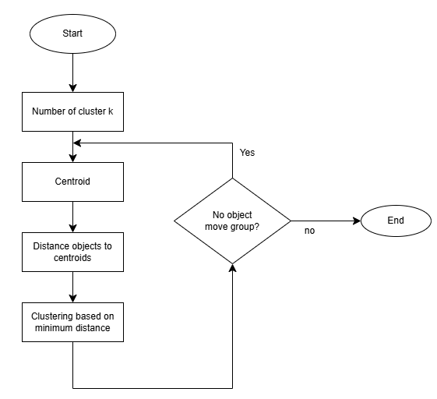
METHODOLOGY-[41] Team Assignment-[2]
FLOWCHART OF K-MEANS CLUSTERING:

Slide 52
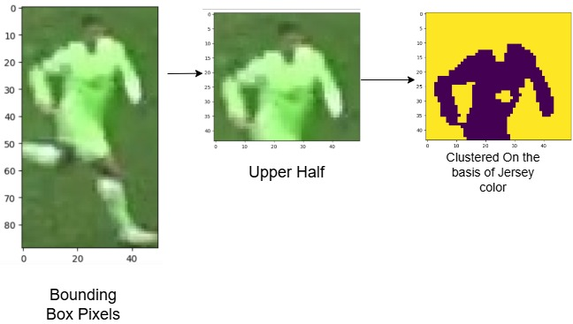
METHODOLOGY-[42] Team Assignment-[3]

Slide 53
METHODOLOGY-[43] Active Player
Now we have to assign the player "active ",the one who have the ball.
This can be done by calculating the distance of the left and right feet of each and every player from the ball using Euclidean distance formula. And the closest distance to ball is assigned the "active" player.

Slide 54
METHODOLOGY-[44] Active Player-[2]
We need to be careful about situations like freekick, passes, corners, etc as here ball can be close to any players, even though it's not in anyones feet.
So to solve this, we need to assign a threshold value such that the distance must at least be equal to the threshold to count as player having the ball. Otherwise the last player will be assigned the "Active player".
This will be used for calculating the team ball posession.

Slide 55
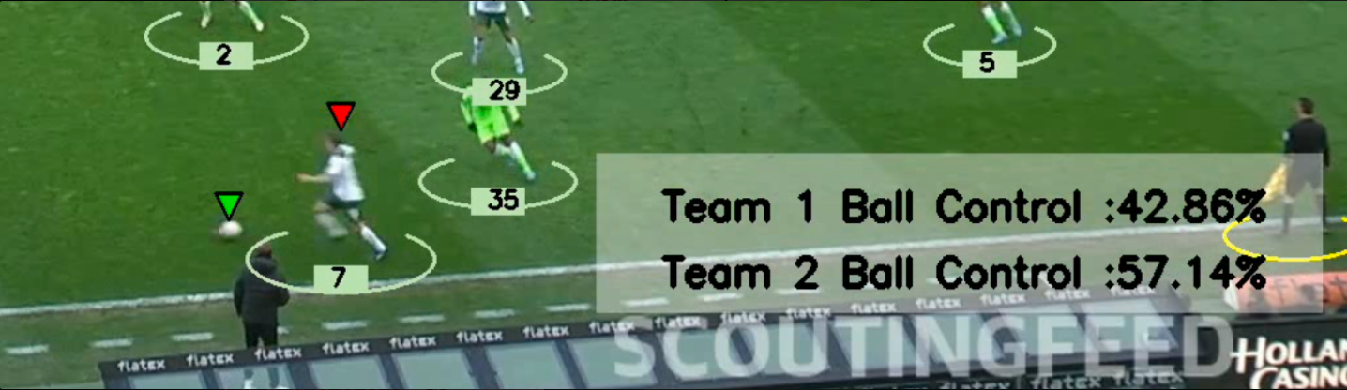
METHODOLOGY-[45] Active Player-[3]

Slide 56
METHODOLOGY-[46] Annotations
Finally, after saving every updates in pickle file. So that we don’t have to do all those processes for same video.
We will be using those tracking data to draw, annotate the frames using Computer vision modules.

Slide 57
METHODOLOGY-[47] Annotations-[2]
Extract frame and copy frame
Draw jersey color ellipse for player using player's bbox
Draw inverse triangle above ball
Draw inverse triangle above ball
Draw yellow ellipse for referee
Draw camera movement in x and y direction
Draw speed and distance
Draw ball possession
Repeat for next frame

Slide 58
METHODOLOGY-[48] Web Integration
Finally, after our model is ready. We integrated our model into local host website using Flask.
It contains frontend part where UI has upload video options and during processing ,our model is inferenced through Flask as Restful API and finally after the processing is done, there is download option in UI to download and view the processes/analyzed video.

Slide 59
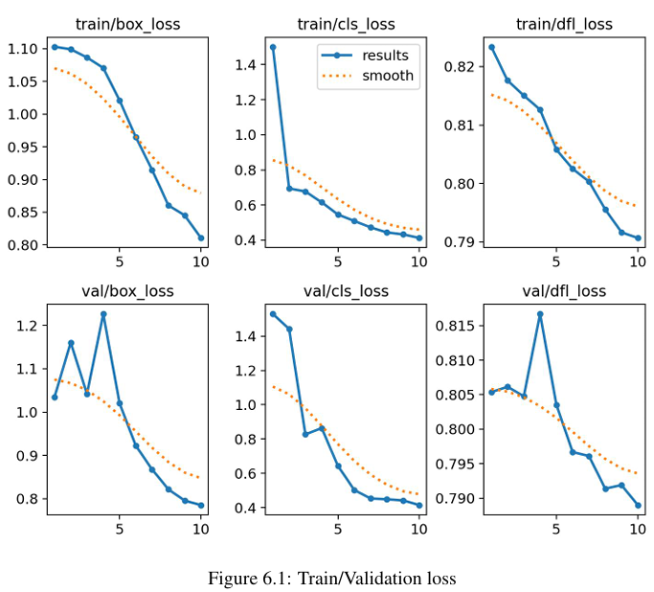
METHODOLOGY – [49] MODEL EVALUATION

Slide 60
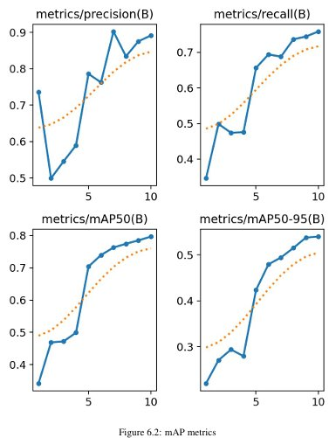
METHODOLOGY – [50]
mAP METRICS

Slide 61
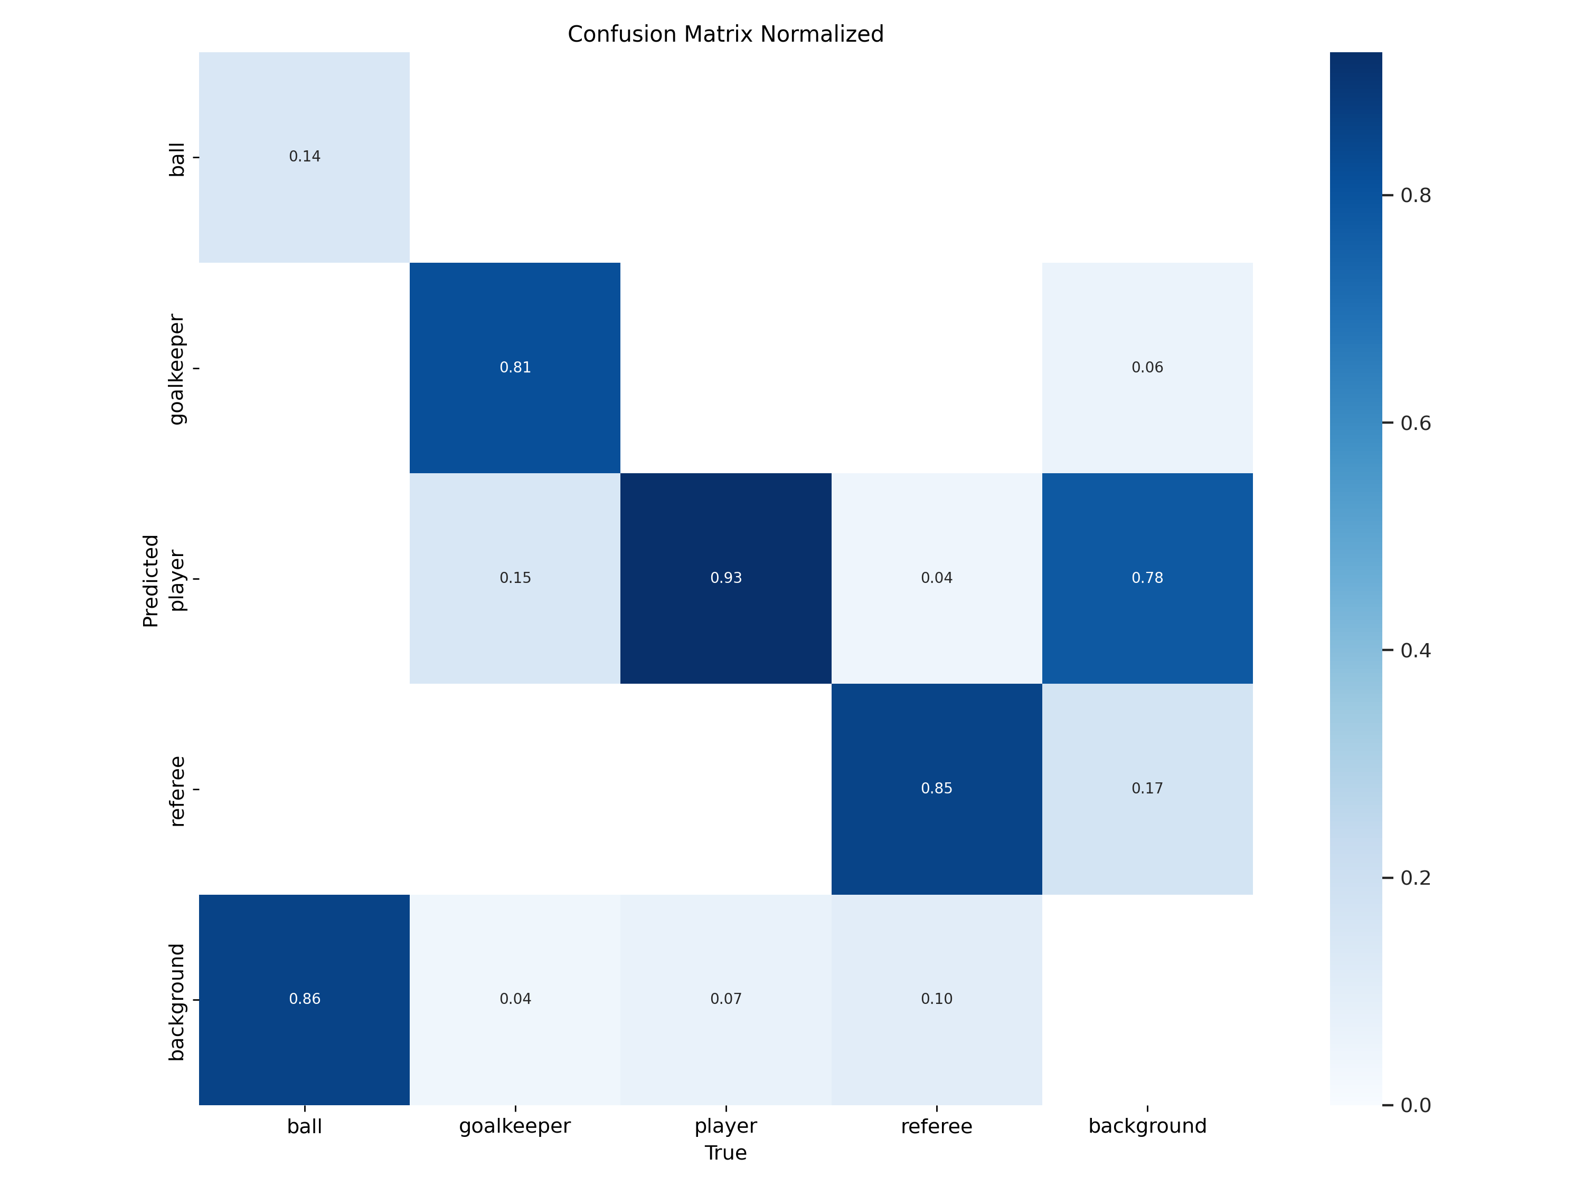
METHODOLOGY – [51] Confusion Matrix

Slide 62
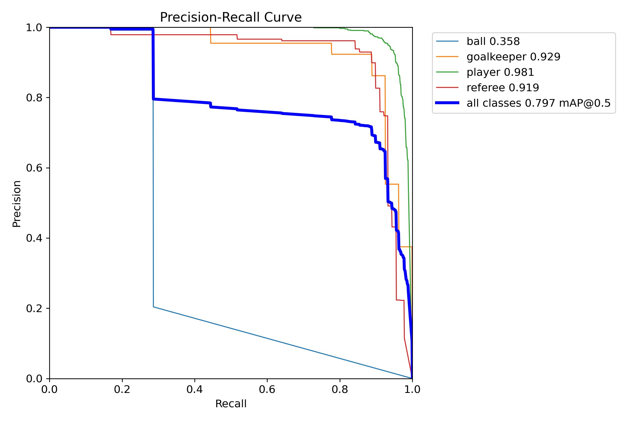
METHODOLOGY – [52] Precision Recall Curve

Slide 63
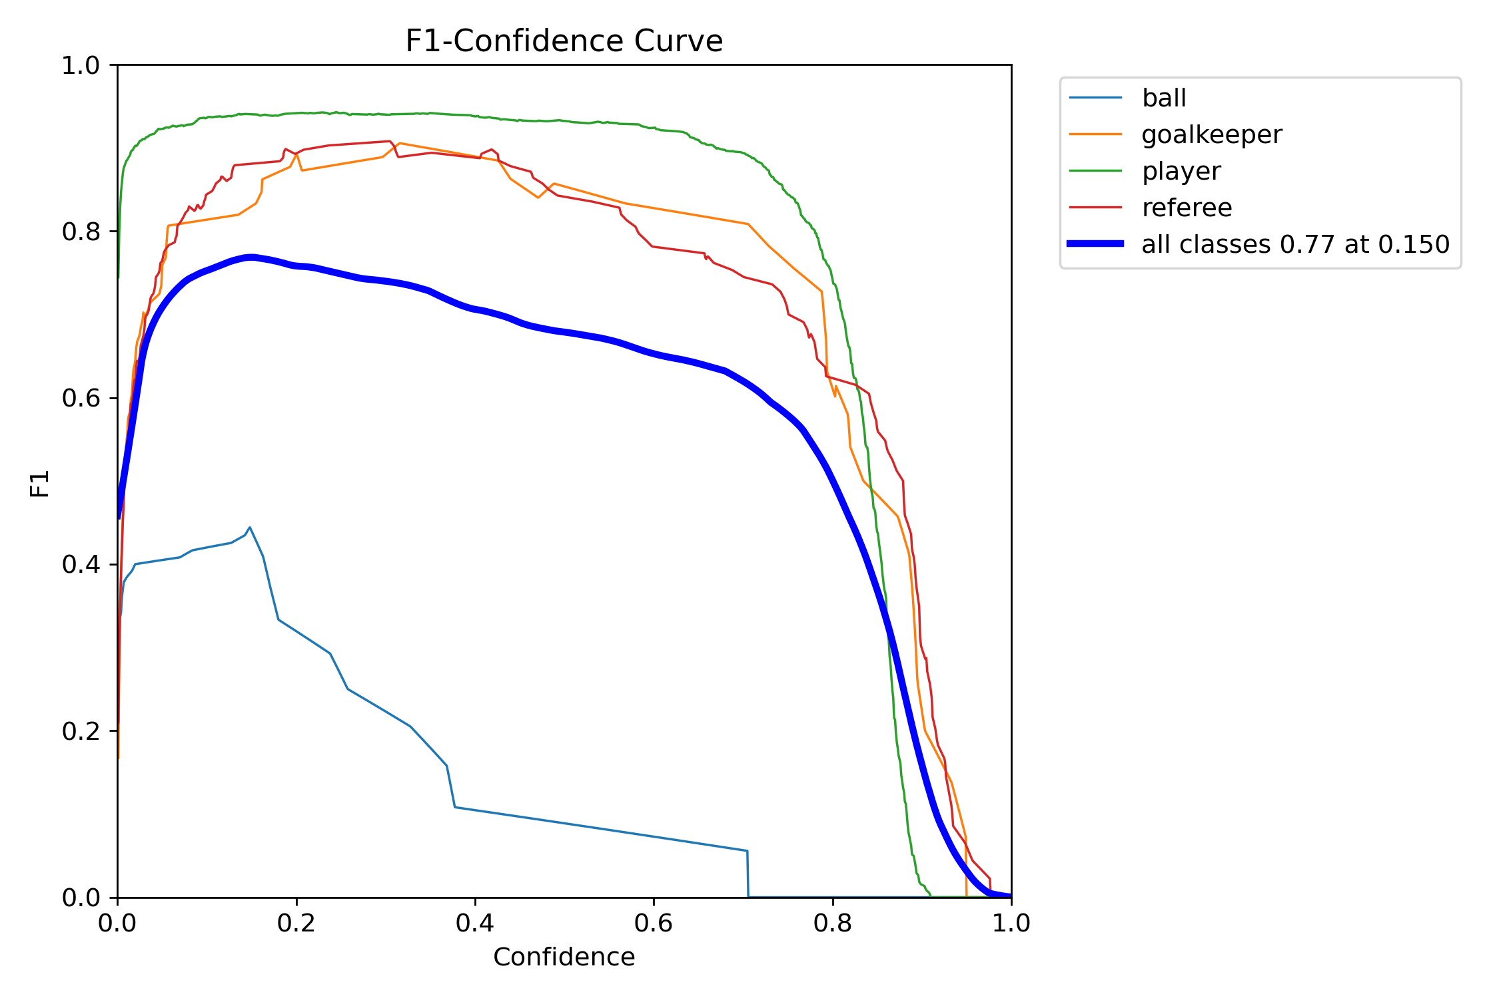
METHODOLOGY-[53] F1 Curve

Slide 64
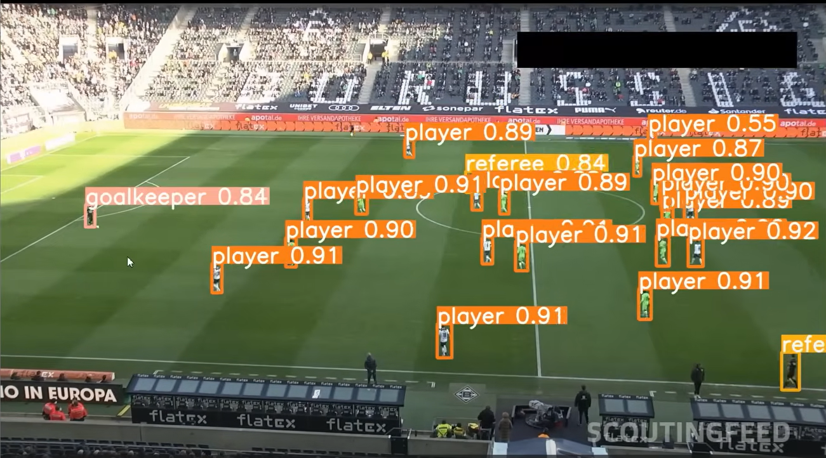
RESULTS
The system utilized YOLO for object detection, enabling accurate identification of players, referees, and the ball in football match videos.

Slide 65
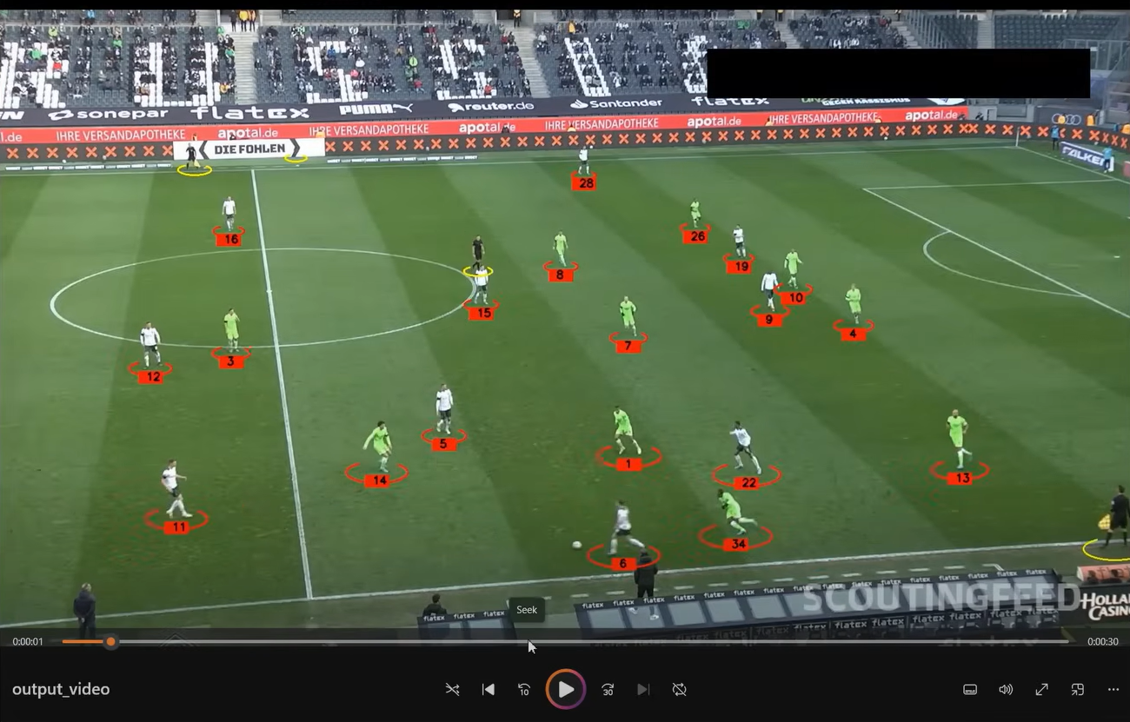
RESULTS-[2]
ByteTrack was integrated for robust multi-object tracking, ensuring consistent player and ball tracking across frames and assigning unique IDs to all players.

Slide 66
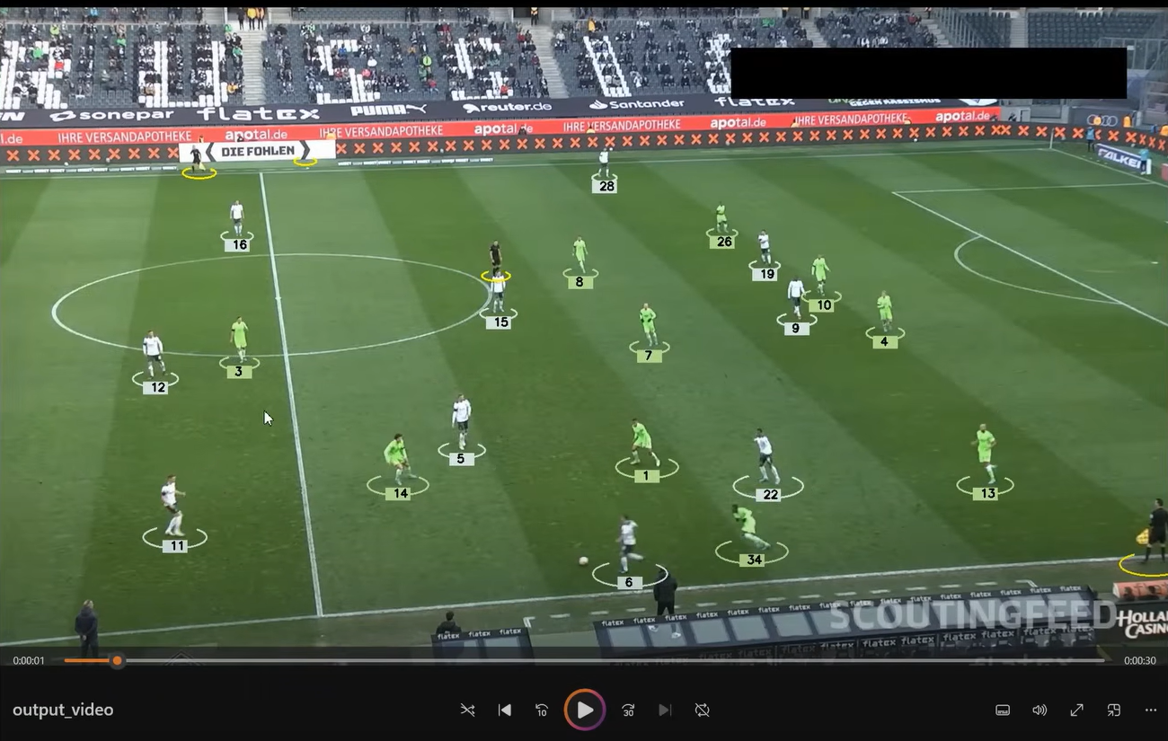
RESULTS-[3]
K-Means clustering was used to assign players to teams based on jersey color, enhancing team identification.

Slide 67
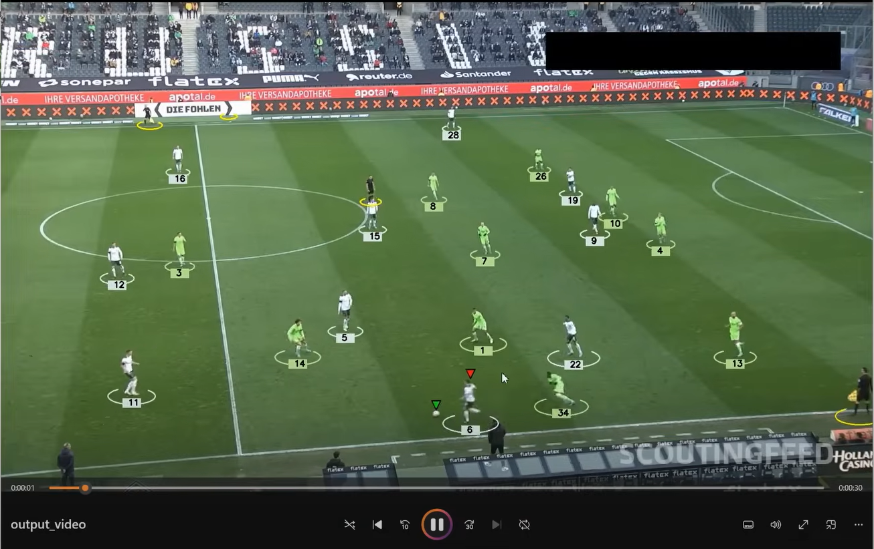
RESULTS-[4]
The active player in each frame was identified using the Euclidean distance calculation to determine the player's closeness to the ball and was assigned a red triangle above them.

Slide 68

RESULTS-[5]
Team ball possession was determined by calculating distance between players and the ball.

Slide 69



RESULTS-[6]
Camera movement was calculated by tracking object position changes between frames, adjusting for panning, zooming, and shifts to maintain accurate tracking.
Before camera shift
After camera shift

Slide 70

RESULTS-[7]
Speed and distance covered by player were calculated using frame-based motion tracking, converting pixel distances into real-world measurements.

Slide 71
DISCUSSION AND ANALYSIS
The system accurately detects and tracks players but struggles with occlusions.
Ball tracking needs improvement in cases of fast movements.
Camera movement compensation improves tracking stability.
Speed and distance calculations provide valuable player performance insights.
Perspective transformation enhances accuracy in field positioning.
Future work includes refining detection accuracy and real-time processing.

Slide 72
FUTURE ENHANCEMENT
Enhancing Accuracy of the System: Expanding the dataset with more labeled images, applying data augmentation, and fine-tune YOLO with larger datasets like SoccerNet or COCO will enhance the system accuracy.
Real-Time Processing in Live Matches: Optimize YOLO inference speed using TensorRT/ONNX, leverage GPU acceleration, and integrate WebRTC for real-time match analysis.
Advanced Ball Tracking & Possession Analysis: Improve ball tracking with Kalman Filters & DeepSORT, predict trajectory, and assign possession by measuring player-ball distance.

Slide 73
FUTURE ENHANCEMENT
Player Action Recognition: Implement an action classification model using pose estimation (OpenPose/MediaPipe) to analyze player movements and tactical execution.
Automatic Event Detection: Use AI with rule-based logic and machine learning to detect goals, fouls, offsides, and automate match event recognition.

Slide 74

PROJECT SCHEDULE

Slide 75
REFERENCES
[1] P. Perez et al. Kalman and particle filtering approaches in player tracking. Journal of Sports Analytics, 23(4):123–145, 2002.
[2] J. Redmon et al. Yolo: You only look once. Proceedings of the IEEE Conference on Computer Vision and Pattern Recognition, pages 779–788, 2016.
[3] Y. Zhang et al. Deepsort: Deep learning-based object tracking. IEEE Transactions on Image Processing, 28(10):4234–4245, 2019.

Slide 76
REFERENCES
[4] J.L. Barron et al. Optical flow estimation and its application to object tracking. IEEE Transactions on Pattern Analysis and Machine Intelligence, 16(5):493–505, 1994.
[5] N. Pappas et al. Homography-based perspective transformation for sports video analysis. Computer Vision and Sports Analytics, 5:90–103, 2018.
[6] Z. Li et al. Real-time performance metrics calculation in sports analytics. Journal of Machine Learning in Sports, 11:234–245, 2019.

Slide 77
REFERENCES
[7] C. Krauss et al. Interactive visualizations for football analytics: Advancements and applications. International Journal of Sports Data Science, 2(1):32–45, 2020.

